Slide 1
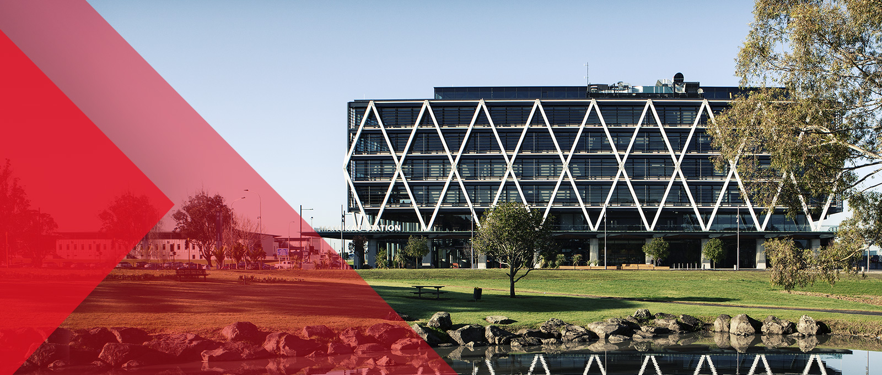
Software Engineering
01: Introduction to Software Engineering
Dr. Seyed Reza Shahamiri More Info

Slide 2

Software Systems
Software systems are abstract and intangible.
They are not constrained by the properties of materials, governed by physical laws, or by manufacturing processes.
Because of the lack of physical constraints, software systems can quickly become extremely complex, difficult to understand, and expensive to change.

Slide 3
What is Software?
Software is a set of meaningful instructions to acquire inputs and to manipulate them to produce the desired output in terms of functions and performance as determined by the user of the software. It is called Computer Programs. Software may comprise of several programs.
It also includes a set of documents, such as the software manual, meant for users to understand the software system.

Slide 4
What is Software?
A software is described by its capabilities. The capabilities relate to the functions it executes, the features it provides and the facilities it offers.
Different software applications have different capabilities and features.

Slide 5
Professional Software Development
Lots of people write programs.
People in business write spreadsheet programs to simplify their jobs,
scientists and engineers write programs to process their experimental data,
and hobbyists write programs for their own interest and enjoyment.
However, the vast majority of software development is a professional activity where software is developed for specific business purposes, for inclusion in other devices, or as software products.

Slide 6
Professional Software Development
Professional software, intended for use by someone apart from its developer, is usually developed by teams rather than individuals.
It is maintained and changed throughout its life.
Software engineering is intended to support professional software development, rather than individual programming.

Slide 7
Software Product Classes
Software engineers are concerned with developing software products (i.e., software which can be sold to a customer). There are three classes of software products:
Generic (software) products: These are stand-alone systems that are produced by a development organization and sold on the open market.
Software as a service (SaaS): is a software licensing and delivery model in which software is licensed on a subscription basis and is centrally hosted. This types of software are usually delivered via cloud platforms.
Customized (software) products: These are systems that are commissioned by a particular customer.
A software contractor develops the software especially for that customer.

Slide 8

Software as a Service
RDBMS
NoSQL
XML
Web Service
Web Service
Web Service
The Cloud
Desktop
Web App

Slide 9
Software Product Classes
An important difference between these classes of software is that, in generic products and SaaS, the organization that develops the software controls the software specification.
For custom products, the specification is usually developed and controlled by the organization that is buying the software. The software developers must work to that specification.

Slide 10
Different Types of Software
System Software: A collection of programs written to service other programs at system level.
Examples: compiler, operating systems
Real-time Software: Programs that monitor/analyze/control real world events as they occur.
Examples: Car controlling software
Business Software: Programs that access, analyze and process business information.
Examples: Word processing software, spreadsheets, accounting software etc.

Slide 11
Different Types of Software
Engineering and Scientific Software: Software using “number crunching” algorithms for different science and applications such as system simulation, computer-aided design.
Examples: Weather predicting software, Statistical software like R and SPSS

Slide 12
Different Types of Software
Embedded Software: These software are used to control products and systems for the consumer and industrial markets, i.e., they are written to control specific hardware functions. It has very limited and specific functions and control capability.
Examples: Such ‘build in' embedded software runs in electronics appliances, in cars, telephones, modems, cell phones, robots, security systems etc.
Internet Software: These are programs that support internet accesses and applications.
Examples: Search engine, browser, e-commerce software, authoring tools

Slide 13
Essential attributes of good software
Product characteristic | Description
Maintainability | Software should be written in such a way so that it can evolve to meet the changing needs of customers. This is a critical attribute because software change is an inevitable requirement of a changing business environment.
Dependability and security | Software dependability includes a range of characteristics including reliability, security and safety. Dependable software should not cause physical or economic damage in the event of system failure. Malicious users should not be able to access or damage the system.
Efficiency | Software should not make wasteful use of system resources such as memory and processor cycles. Efficiency therefore includes responsiveness, processing time, memory utilisation, etc.
Acceptability | Software must be acceptable to the type of users for which it is designed. This means that it must be understandable, usable and compatible with other systems that they use.

Slide 14
Why do software projects fail? Class Activity
In groups of 4-5 students, discuss at least three reasons why software projects fail.

Slide 15
Why do software projects fail?
There are several reasons that make a software project fails. For example:
Difficult to accurately estimate how long the project will take.
Developers typically overestimate/overstate their productivity.
Requirements (i.e. customer needs) are not always clearly defined.
Requirements are not always realistic.
Requirements are always changing.

Slide 16
What is Software Engineering
Software engineering is an engineering discipline that is concerned with all aspects of software production from the early stages of system specification through to maintaining the system after it has gone into use.
Engineering discipline: Engineers make things work by applying theories, methods, and tools where these are appropriate. Engineering is about getting results of the required quality within the schedule and budget.
All aspects of software production: Software engineering includes technical processes of software development as well as activities such as software project management and the development of tools, methods, and theories to support software production.

Slide 17
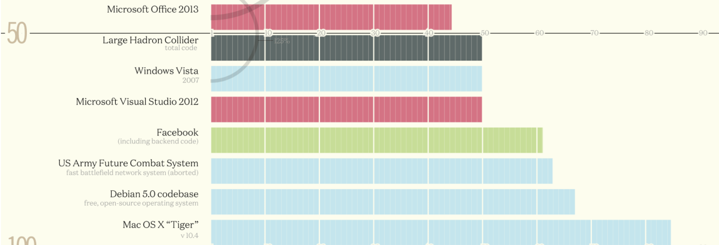
Importance of Software Engineering
To handle ‘complexity’ in the code which results owing to factors like ‘massive volumes of code’ and ‘distributed environment’
Million line of code

Slide 18
Importance of Software Engineering
To handle the continuing changing ‘environment’ and ‘demands’ as more and more, individuals and society rely on advanced software systems.
To keep a track on the ‘timing’ and ‘budget requirements’.
To maintain ‘efficiency’ in delivering the end products.

Slide 19
Computer Science Vs. Software Engineering Class Activity
Research “computer science” and identify how it is different from software engineering. Discuss your findings in your group.

Slide 20
Computer Science Vs. Software Engineering
Computer Science theories act as a foundation for practical aspects of software engineering.
However, software engineering is concerned with the practical problems of producing software.
Some knowledge of computer science is essential for software engineers.
Computer science theory, however, is often most applicable to relatively small programs.

Slide 21
System Engineering Vs. Software Engineering
System engineering is concerned with all aspects of the development and evolution of complex systems where software plays a major role.
System engineering is therefore concerned with
hardware development,
policy and process design and system deployment,
and software engineering.
System engineers are involved in
specifying the system,
defining its overall architecture,
and then integrating the different parts to create the finished system.

Slide 22
Different Types of Software Engineering-related Jobs/Roles Available in the Market
Systems Analyst: analyzes requirements for an application, may do business case (economic) analysis.
Software Architect: designs the overall structure of the application.
Software Network Specialist: LAN/WAN Network design, installation, maintenance.
Software Programmer: implements the design using software development tools, software products, and computer languages.

Slide 23
Different Types of Software Engineering-related Jobs/Roles Available in the Market
Software Systems Administrator: administers user accounts, technology refreshment, software deployment to users, software problem solvers.
Software Database Administrator: administers the database (installation, maintenance, backup)
Customer Support Engineer: solves customers and end-users problems with computer applications, configuration (e.g. ISP)
Webmaster: designs, implements, and maintains a web site

Slide 24
Different Types of Software Engineering-related Jobs/Roles Available in the Market
Software Security Engineer: identification, authorization, authentication, data protection, data integrity
Software Tester: verification, validation, finding bugs, writing test scripts

Slide 25
General issues in all types of software Class Activity
There is no universal software engineering method or technique that is applicable for all types of software.
However, there are general issues that affect many different types of software. Discuss them in your group.

Slide 26
General issues in all types of software
1. Heterogeneity:
Increasingly, systems are required to operate as distributed systems across networks that include different types of computer and mobile devices probably programmed in different languages and/or technologies, or to be integrated to older legacy systems.
The challenge here is to develop techniques for building dependable software that is flexible enough to cope with this heterogeneity.

Slide 27
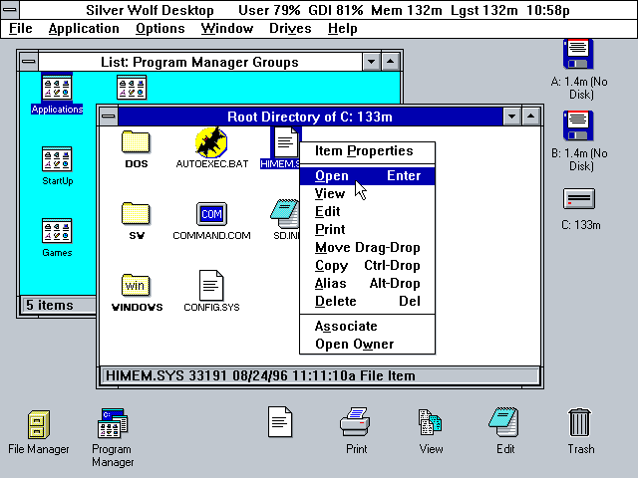
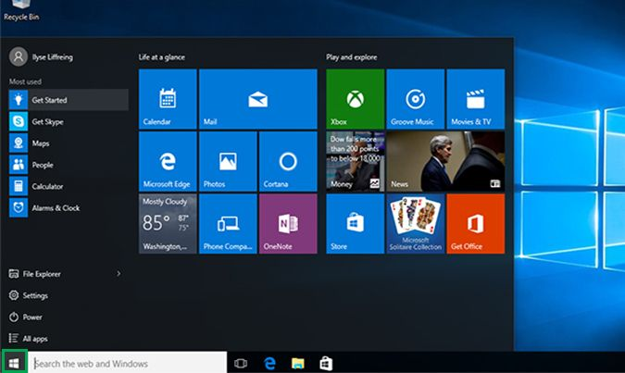
General Issues in all types of software
2. Business and social change
Businesses and societies are changing incredibly quickly as emerging economies develop and new technologies become available.
They need to be able to change their existing software and to rapidly develop new software.
Tradition software development techniques need to evolve so that the time required for software to deliver values to its customers is reduced.
Windows 3.1 to Windows 10

Slide 28
General Issues in all types of software
3. Security and trust
As software is intertwined with all aspects of our lives, it is essential that we can trust that software.
This is especially true for remote software systems accessed through a web page or web service interface.
We have to make sure that malicious users cannot attack our software and that information security is maintained.

